Slide 1
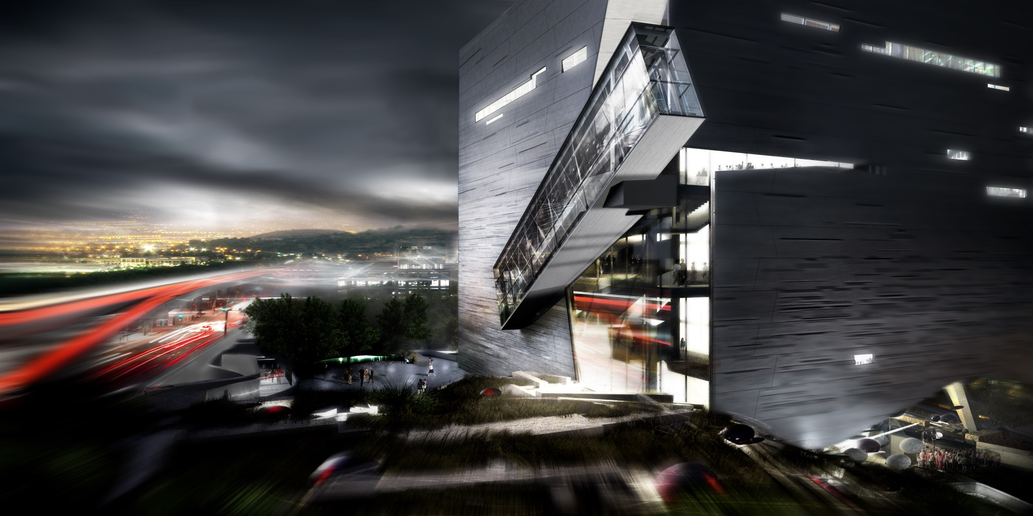
Perot Museum of Nature and Science Schematic Lighting Design Presentation
Yucheng Lu
Lighting/Electrical
Notes:
Good afternoon. I’m yucheng and today I will be presenting my schematic lighting design for perot (pir rot) museum of nature and science at Dallas(da lees), Texas

Slide 2
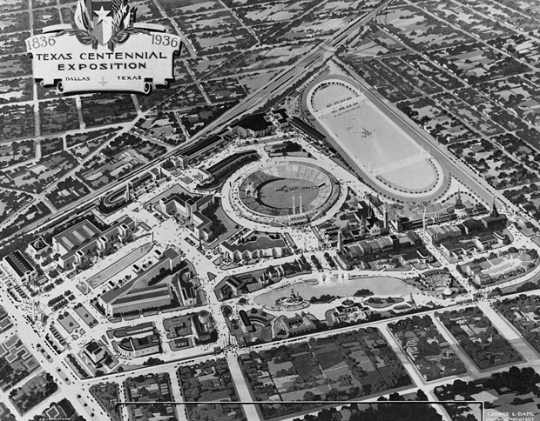
Dallas Museum of Natural History - 1936
History | Site | Vision | Overview | Education | Theater | Lobby | Facade | Escalator 1
Notes:
The museum has nearly 70 years history. It first established in 1936 as the Dallas Museum of Natural (nai tural) History to celebrate 100 year’s anniversary of the state of texas.

Slide 3
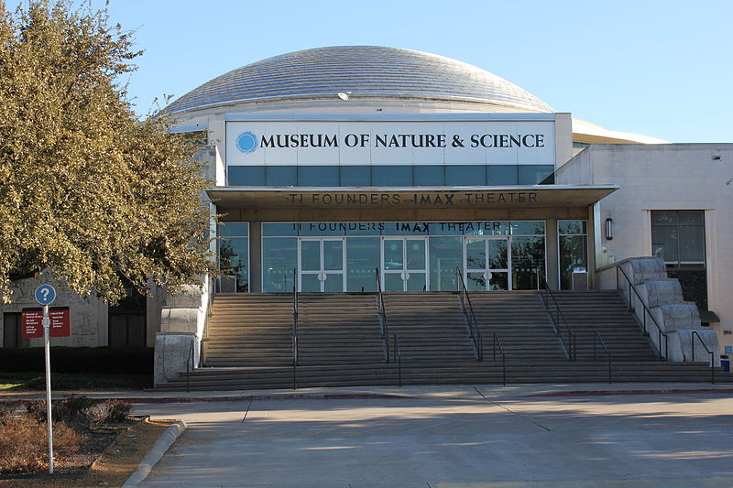
Dallas Museum of Nature and Science - 2006
History | Site | Vision | Overview | Education | Theater | Lobby | Facade | Escalator 1
Notes:
In 2006, the Museum oversees the importance to incorporate modern science as part of the exhibition as well as the marking potential of familiy school visitors. Therefore, the original Museum merged with two other museums, the science place and the Dallas Children's Museum and became the new dallas museum of nature and science.

Slide 4
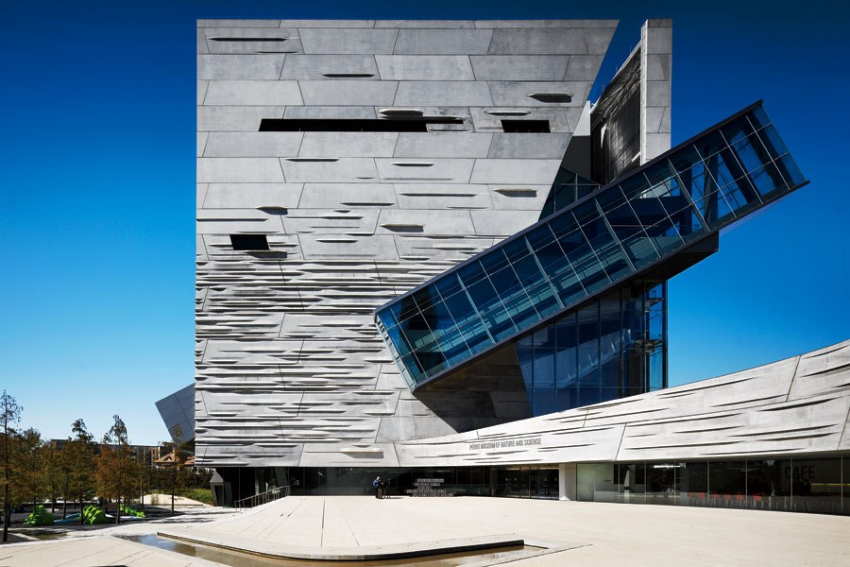
Perot Museum of Nature and Science - 2012
History | Site | Vision | Overview | Education | Theater | Lobby | Facade | Escalator 1
Notes:
The merge turns out to be a brilliant decision. In response to the increasing interest of Dallas citizens, the museum relocated into victory park campus next to downtown area, offering more advanced exhibition with easier access. In order to recognize a generous donation of 50 million dollars from Mr. Ross Perot, the museum was also renamed to be Perot Museum of Nature and Science as we see today.

Slide 5
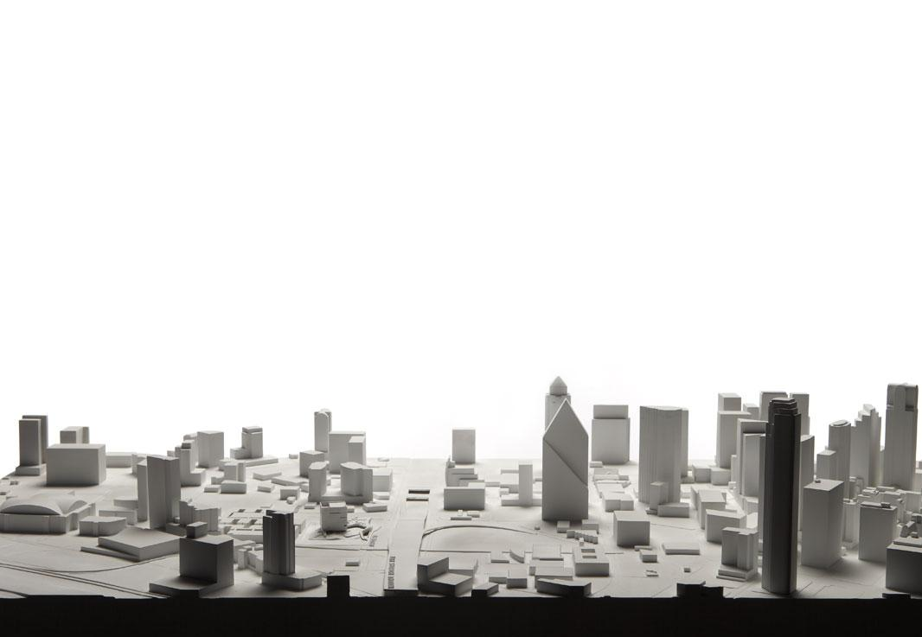
Victory Park | Down Town
N
History | Site | Vision | Overview | Education | Theater | Lobby | Facade | Escalator 2
Notes:
Victory park is located north from downtown Dallas. The district is developed by Ross Perot Jr., son of Ross Perot.

Slide 6
Victory Park | Down Town
N
History | Site | Vision | Overview | Education | Theater | Lobby | Facade | Escalator 2
Notes:
If you are a basketball fan, you might already know that american airline center, home of dallas mavericks is also located in Victory Park. Now if you compare the building on both side, It is obvious that building in down town area are significantly taller including skyscrapers like the 900 feet bank of America plaza and 700 feet fountain place for fountain health care.

Slide 7
Victory Park | Down Town
N
History | Site | Vision | Overview | Education | Theater | Lobby | Facade | Escalator 2

Slide 8
Victory Park | Down Town
N
History | Site | Vision | Overview | Education | Theater | Lobby | Facade | Escalator 2

Slide 9
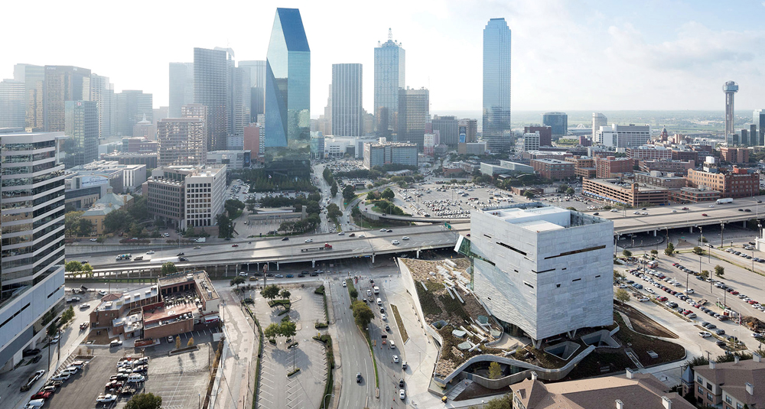
History | Site | Vision | Overview | Education | Theater | Lobby | Facade | Escalator 3
Notes:
Our museum is located on the border of victory park facing downtown area, place in between two distinct architectural style, urban plan as well as lighting styles.

Slide 10
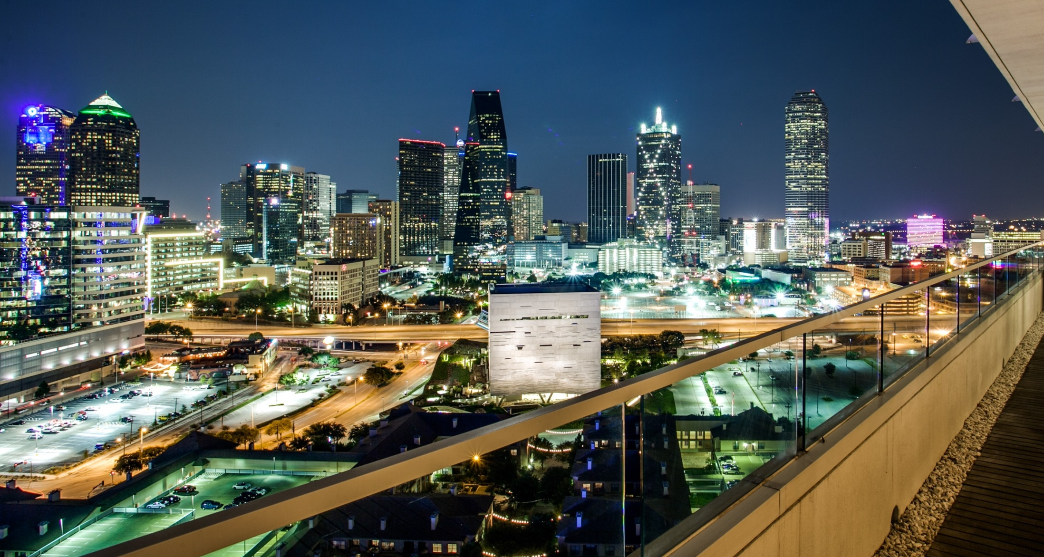
History | Site | Vision | Overview | Education | Theater | Lobby | Facade | Escalator 4
Notes:
You can see that there are much more light coming from the down area, even the parking lot on the other side is brighter

Slide 11
“I envision Victory Park as an urban lifestyle destination”
- Ross Perot, Donor & Developer
History | Site | Vision | Overview | Education | Theater | Lobby | Facade | Escalator 5
Notes:
This state of coexistence of brought by Ross Peort, who envision victory park as a urban landscape destination, inviting tenants like restaurant, club and luxury apartments to settle in this area.

Slide 12
“I envision Victory Park as an urban lifestyle destination”
- Ross Perot, Donor & Developer
“Once museums were combined, the ambition was to replace them with a new building that would seamlessly unite these variegated strands”
“We are Excited to bring some amazing family attractions”
- Nicole Small, Museum CEO
History | Site | Vision | Overview | Education | Theater | Lobby | Facade | Escalator 5
Notes:
On the museum site, the CEO Mrs. Nicole Small concerned more about the how new facility can help the museum of its merging process while attracting family visitor, especially children with interactive falicities.

Slide 13
“I envision Victory Park as an urban lifestyle destination”
- Ross Perot, Donor & Developer
“Once museums were combined, the ambition was to replace them with a new building that would seamlessly unite these variegated strands”
“We are Excited to bring some amazing family attractions”
- Nicole Small, Museum CEO
“The experience is about a sequence of moving, a journey. The whole building is about being didactic and itself is an exhibit.”
“The building is compelling and will expand user’s imagination. Everywhere in the building will be left transparent and you will understand architecture”
“The subject of the building: how we understand nature and ecological terms and how it is an absolutely vital issue, is exactly where we are at this moment of time”
- Thom Mayne, Morphosis Architect
History | Site | Vision | Overview | Education | Theater | Lobby | Facade | Escalator 5
Notes:
As the chief architect, Mr. Thom Mayne and his design team from morphosis(mor(up) phei sis) architect focus more on the architecture itself. He envision the museum itself being an exhibit, actively presenting building systems to inspire visitors in architectural design as well as the environmental issues.

Slide 14
Urban
Awareness
Entertain
Unite
Nature
Science
Inspire
History | Site | Vision | Overview | Education | Theater | Lobby | Facade | Escalator 6
Notes:
Incorporating visions from urban planer, business manager and architect, the key word of my design will be unite. How urban lifestyle can be united with modern technology to provide a brand new entertainment. How since nature can be united to inspire next generation and how nature and urban environment can be united to raise awareness of environment protection. Considering that the children will be the major visitor, the priority will be creating a fun experience, adding the feeling of theme park into this museum

Slide 15
History | Site | Vision | Overview | Education | Theater | Lobby | Facade | Escalator 7
Notes:
Here is a brief overview of this building. On the south side of the building is the atrium, equipped with escalators and stairs, Visitors are navigated to the fifth floor through escalator, viewing all the exibits, then take the stair down.

Slide 16
History | Site | Vision | Overview | Education | Theater | Lobby | Facade | Escalator 7
Notes:
Next to the atrium is the core structure containing elevators and emergency exit. The rest of the interior spaces are mostly exhibitions halls.

Slide 17
History | Site | Vision | Overview | Education | Theater | Lobby | Facade | Escalator 7
Notes:
The building has a cubical stracture. Precast concrete panels are wrapped around to provide iconic texture on the cafade

Slide 18
History | Site | Vision | Overview | Education | Theater | Lobby | Facade | Escalator 7
Notes:
The site of this project itself is artificial. The ground level of this building is built 10 feet from the street level, incorporating a landscape plinth that spirals up clock wise from north to south and gaining additional 10 feet to become the roof of level 1.

Slide 19
History | Site | Vision | Overview | Education | Theater | Lobby | Facade | Escalator 8
Notes:
The first space I will introduce is a classroom on basement level. Basement level is designed specifically for young children, providing brief lectures in varies topics.

Slide 20
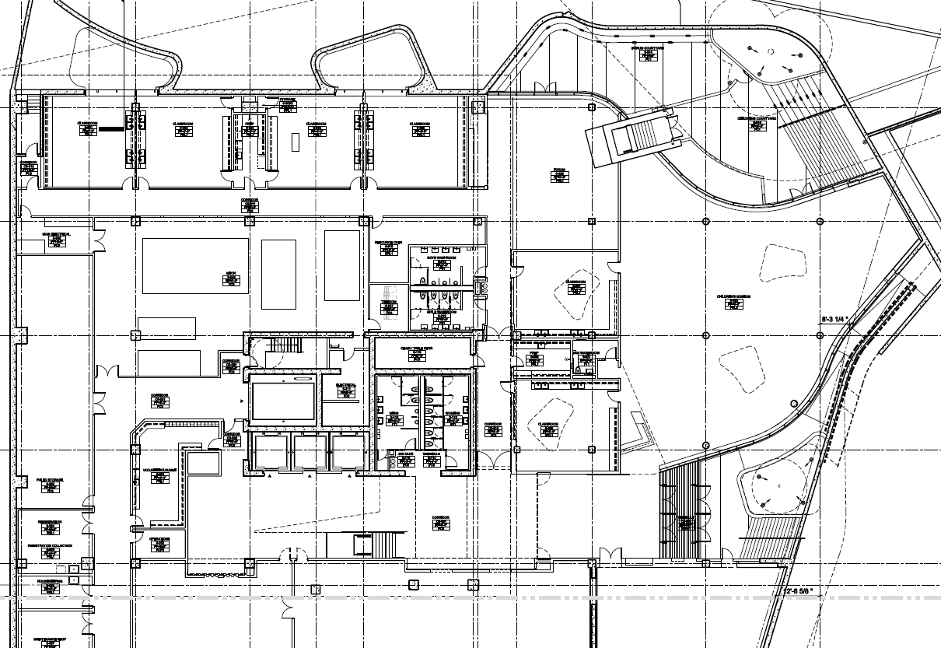
History | Site | Vision | Overview | Education | Theater | Lobby | Facade | Escalator 9
Notes:
The one classroom was built below the landscape plinth (plains), allowing a skylight to be incorporated into the design.

Slide 21
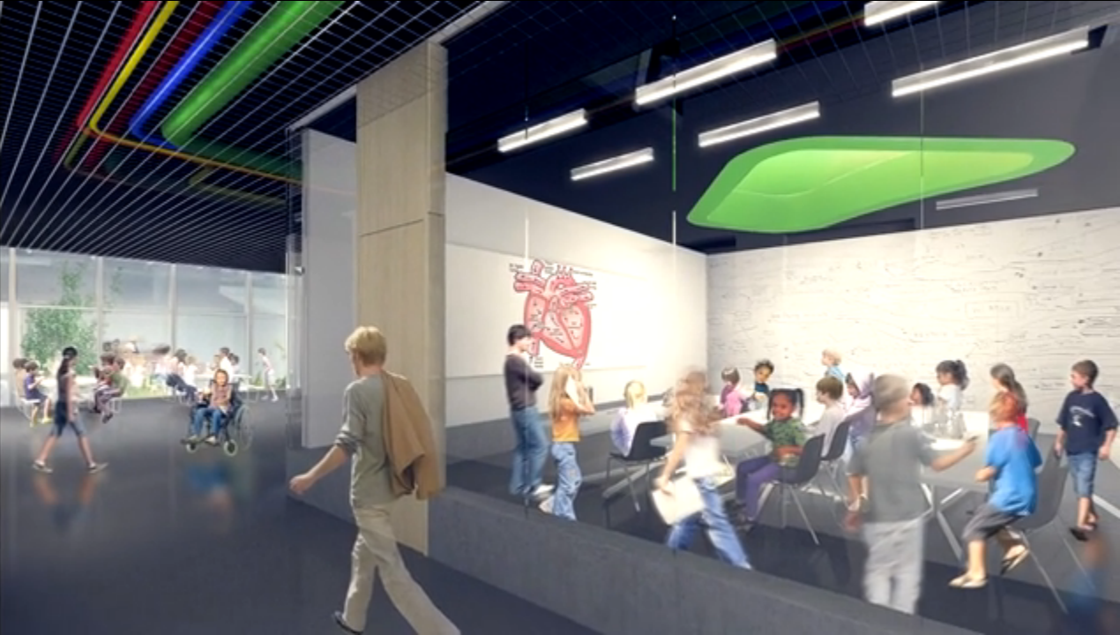
History | Site | Vision | Overview | Education | Theater | Lobby | Facade | Escalator 10
Notes:
The current design adopted linear T5 luminaires, creating a space that perfect for education purpose.

Slide 22
Design Consideration
Promote unique learning experiences using lighting scheme that remarkably distinct from typical education facilities.
Take advantage of the unique roof structure and create a three dimensional lighting system
Eliminating glare to allow occupant observe skylight, mechanical and structural system.
Design Criteria
History | Site | Vision | Overview | Education | Theater | Lobby | Facade | Escalator 11
Notes:
However, making this space looks like an educational facility is something I want to avoid. Imagine children got our of their school classroom, all excited for something new and the first thing they find out is that they are placed in another classroom. So my design should definitely make this space something else. Also, because the room is built right below a unique roof structure made of a skylight and sloped landscape plinth(pleenth), I want to take advantage of it, creating a transparent space that visitor can observe the structure of skylight as well as mechanical and structural systems. Additional ceiling height also allows me to design light into a three dimensional system.

Slide 23
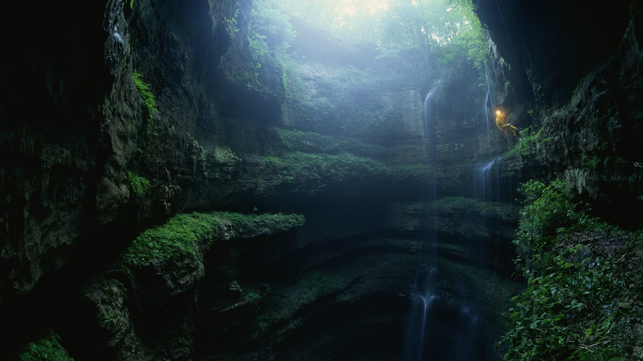
History | Site | Vision | Overview | Education | Theater | Lobby | Facade | Escalator 12
Notes:
To children, the word ‘underground’ are often associated to dungeon, darkness and adventure. Therefore, I’ll make this room the adventure land of this museum, creating a underground world to be explored.

Slide 24
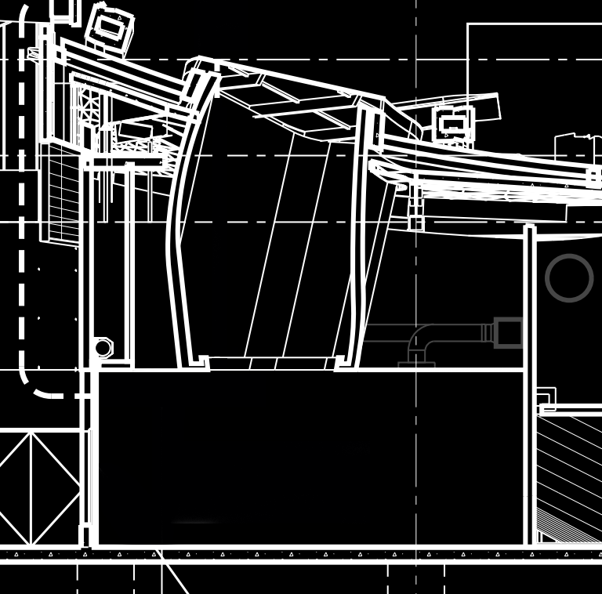
History | Site | Vision | Overview | Education | Theater | Lobby | Facade | Escalator 13
Notes:
To transform a basement into a cave, the first thing you need to do is remove the ceiling. By controlling the light level on the very top we can create a illusion that this space is much deeper than it is.
Luminaires used in this room should also be an element of the cave, like sclactites. I will have cylinder luminaires of different size pending from different locations in different suspension length, all of this is intendant to mimic the unpredictable creation of nature.
Skylight is also a vital element of the building. Adequate daylight allow cave plant to flourish. The inner side of the skylight is painted green already, in addition, decorative fiber optic will be used to represent veins reaching down.
In the end, for functional lighting we will also have recessed wall washer to light up the white board and flood light inside skylight to simulate daylight gain at night
Luminaire used

Slide 25
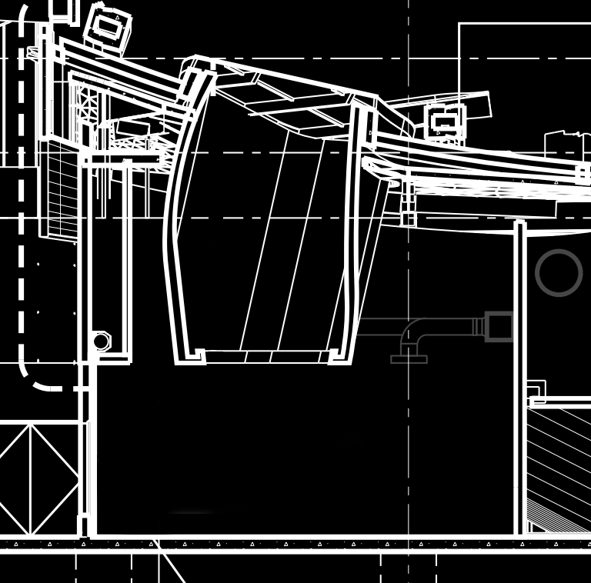
History | Site | Vision | Overview | Education | Theater | Lobby | Facade | Escalator 13

Slide 26
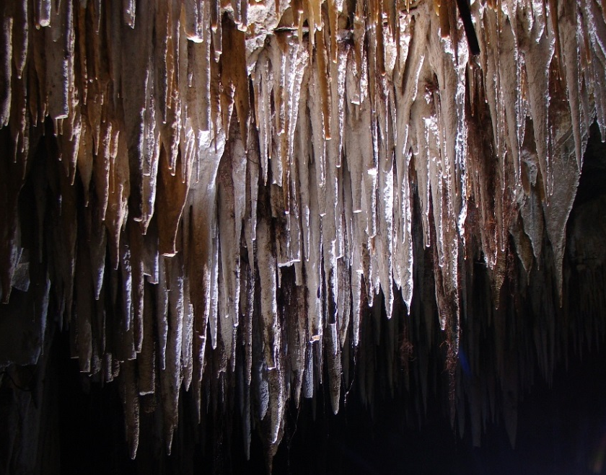
Stalactite
History | Site | Vision | Overview | Education | Theater | Lobby | Facade | Escalator 13
Notes:
The

Slide 27
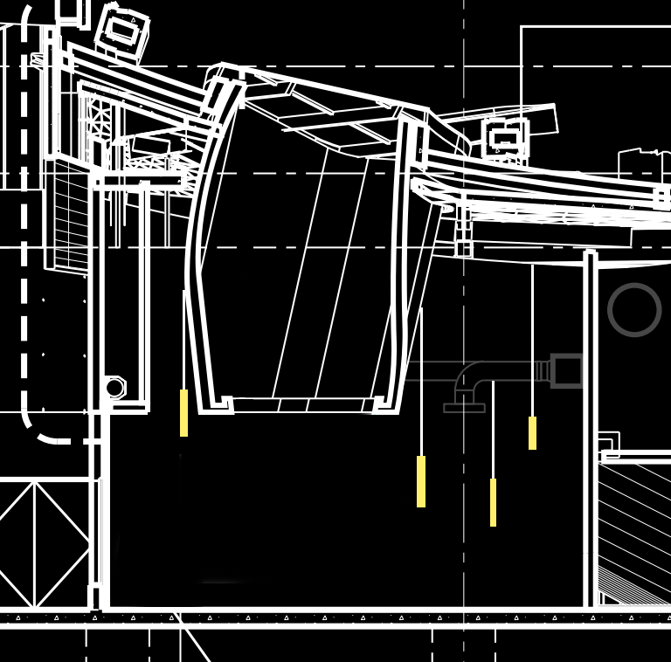
Stalactite
History | Site | Vision | Overview | Education | Theater | Lobby | Facade | Escalator 13
Notes:
Add human figure to show scale

Slide 28
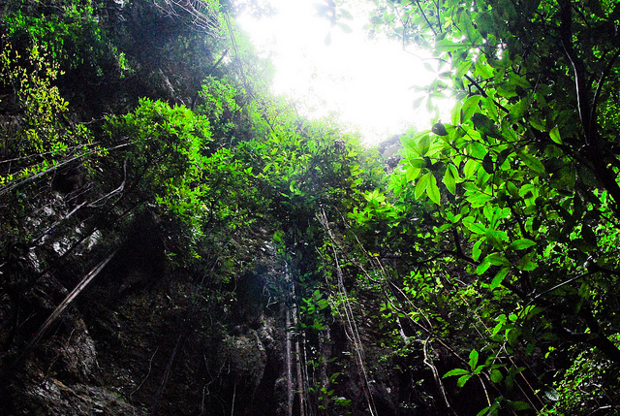
Stalactite
Cave Plants
History | Site | Vision | Overview | Education | Theater | Lobby | Facade | Escalator 13

Slide 29
Stalactite
Cave Plants
History | Site | Vision | Overview | Education | Theater | Lobby | Facade | Escalator 13

Slide 30
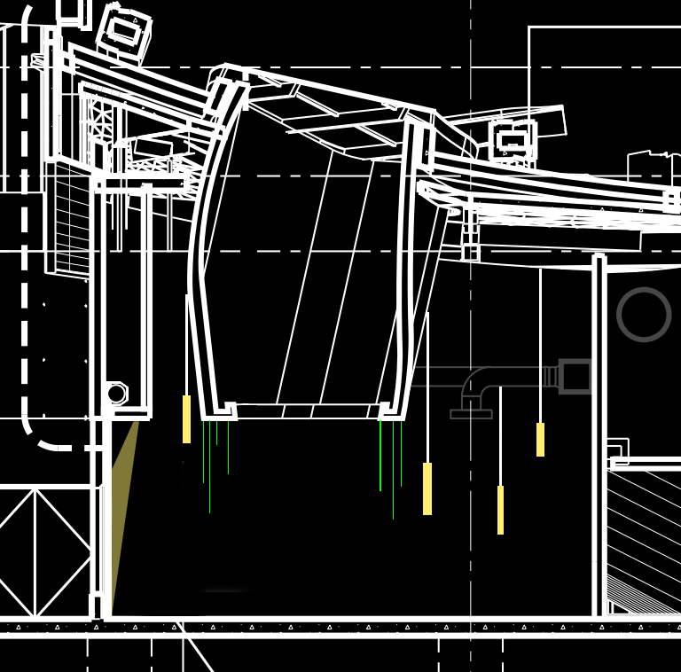
Stalactite
Cave Plants
History | Site | Vision | Overview | Education | Theater | Lobby | Facade | Escalator 13

Slide 31
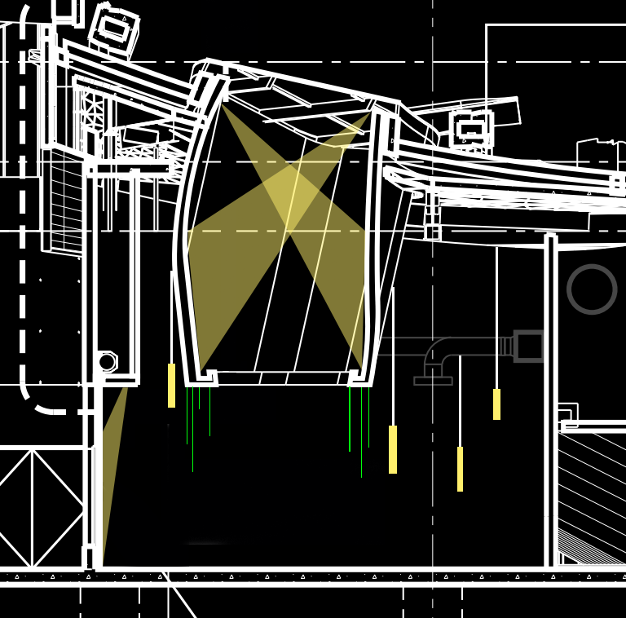
Stalactite
Cave Plants
History | Site | Vision | Overview | Education | Theater | Lobby | Facade | Escalator 13

Slide 32
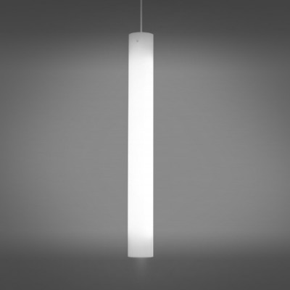
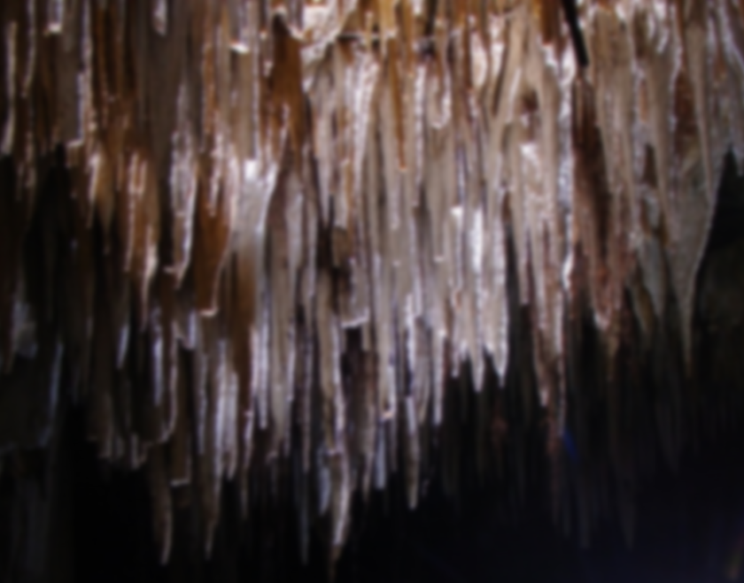
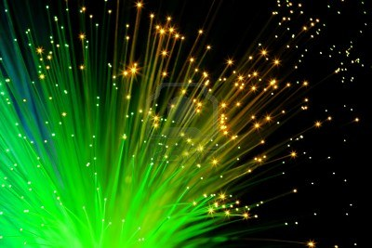
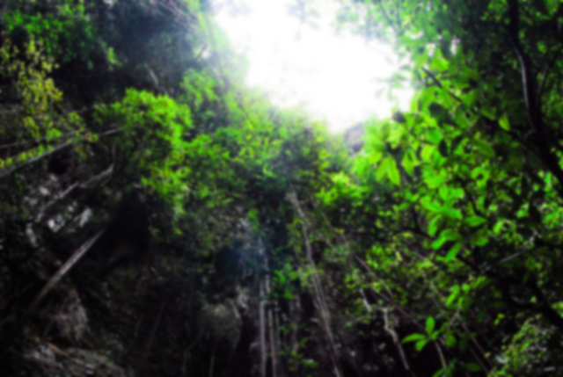
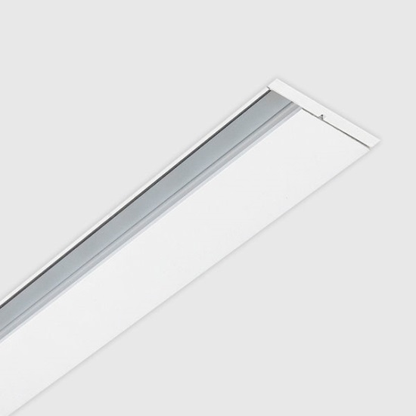
Stalactite
Cave Plants
History | Site | Vision | Overview | Education | Theater | Lobby | Facade | Escalator 13

Slide 33
History | Site | Vision | Overview | Education | Theater | Lobby | Facade | Escalator 14
Notes:
The theater space located under the landscape roof is the a high tech facility designed for 3D movie shows. Unique acoustic panels are designed around the space not only guaranteed the sound quality but also provided great potential for cove lighting

Slide 34
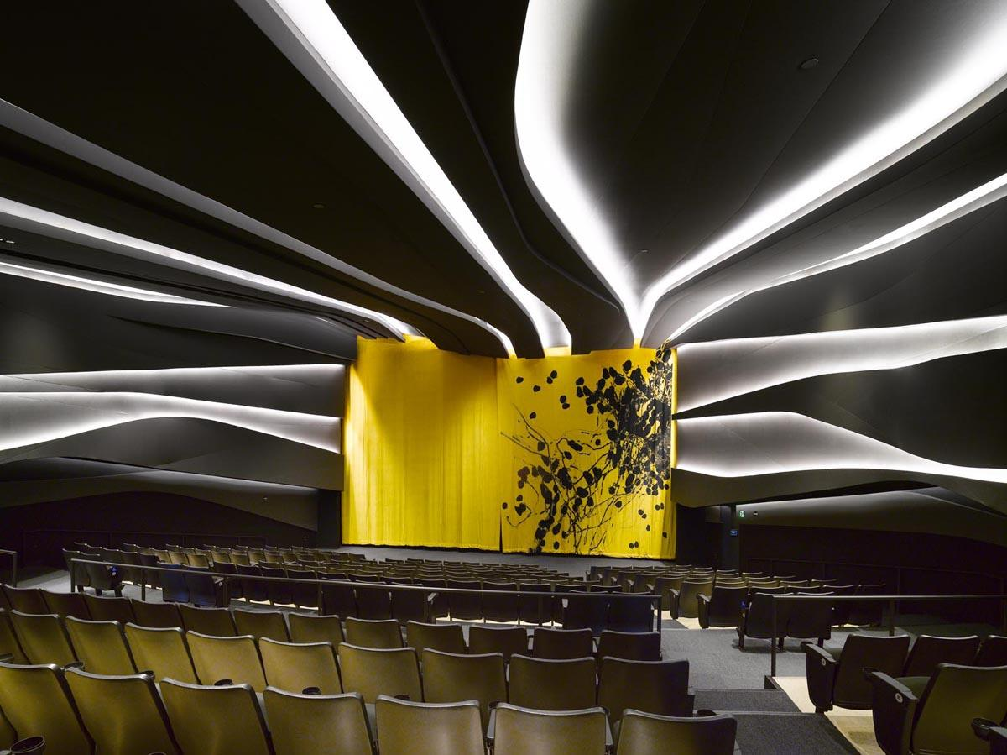
History | Site | Vision | Overview | Education | Theater | Lobby | Facade | Escalator 15
Notes:
Unique acoustic panels are designed around the space not only guaranteed the sound quality but also provided great potential for cove lighting.

Slide 35
Design Consideration
Design a scheme that celebrates the highest standard of modern technology
Create a smart lighting control system that corporates with occupancy sensor to provide navigation though light level change
Design Criteria
History | Site | Vision | Overview | Education | Theater | Lobby | Facade | Escalator 16
Notes:
The theater represents the height standard of applied science in this museum, providing inspiring visual feast that do not exist in nature. Therefore I want this space to be the tomorrow land of this museum celebrating the scientific achievement of mankind.
The 3D movie lasts for 20 minutes and after each movie there will be 20 minutes interval for evacuation and reseating. Therefore I will have lighting system to assist this operation using advanced control systems, which is also a celebration of scientific achievement.

Slide 36
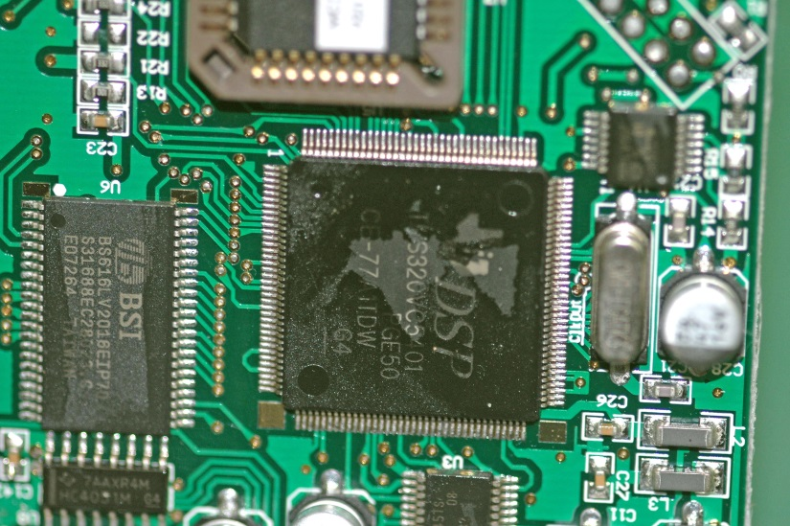
History | Site | Vision | Overview | Education | Theater | Lobby | Facade | Escalator 17
Notes:
Computer, iphone, ipad, most of the modern electronic devices rely on a chip to operate, making this small chip a perfect representation of dodern computer science.

Slide 37
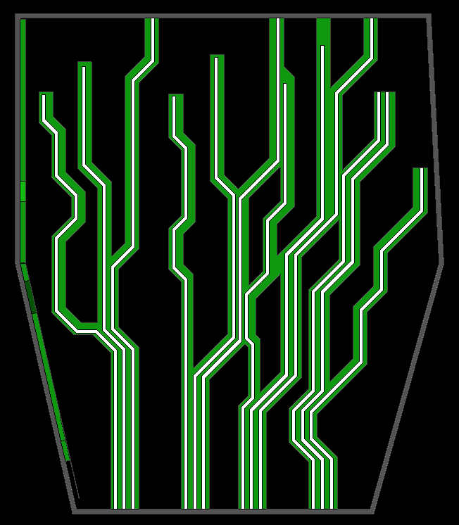
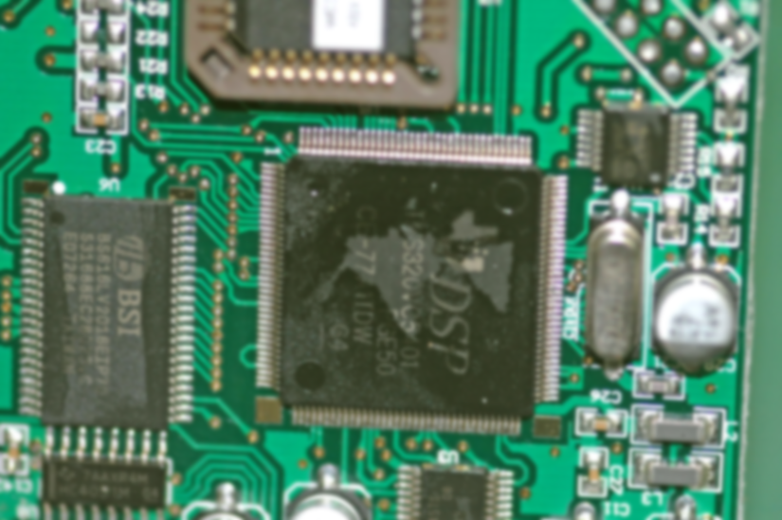
History | Site | Vision | Overview | Education | Theater | Lobby | Facade | Escalator 17
Notes:
Computer, iphone, ipad, most of the modern electronic devices rely on a chip to operate, making this small chip a perfect representation of dodern computer science. Branch of the light expands as it move toward the back of the room, showing how many information could be included in a simple combination of 0 and 1 codes

Slide 38
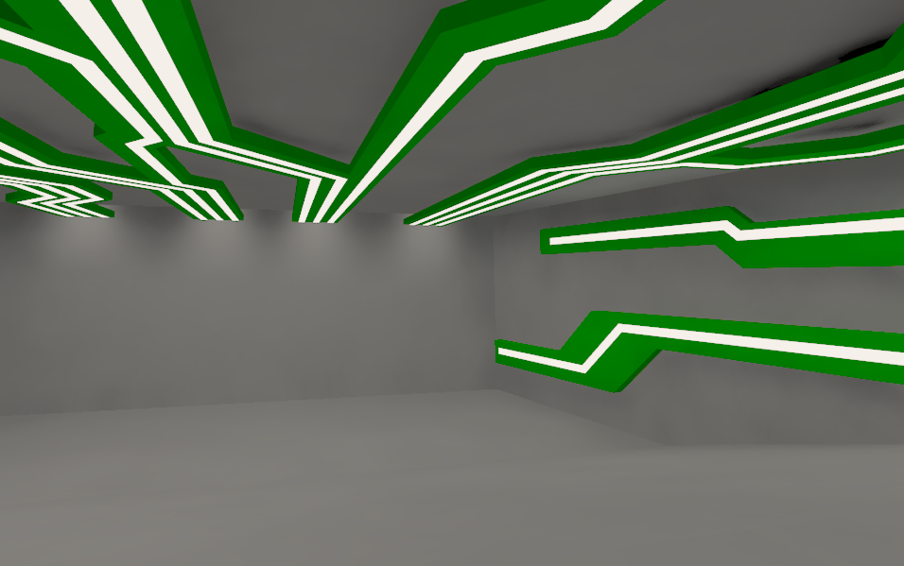
History | Site | Vision | Overview | Education | Theater | Lobby | Facade | Escalator 18
Notes:
The outline of acoustic panel will have less curvature to match the concept. Each branch of light covers certain area of the room, by adjusting their brightness we can help audience find available seating

Slide 39
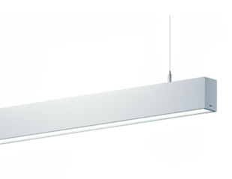
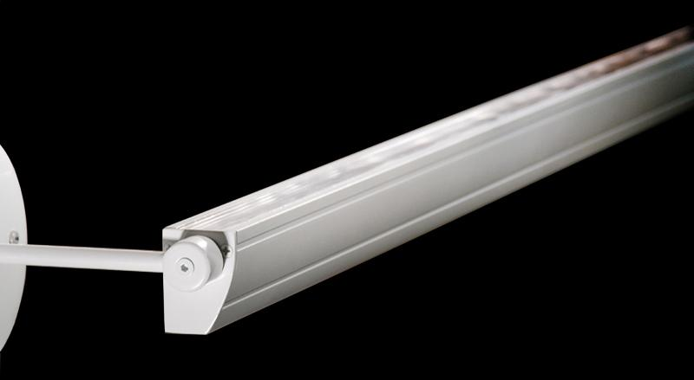
History | Site | Vision | Overview | Education | Theater | Lobby | Facade | Escalator 18
Notes:
The outline of acoustic panel will have less curvature to match the concept. Each branch of light covers certain area of the room, by adjusting their brightness we can help audience find available seating

Slide 40
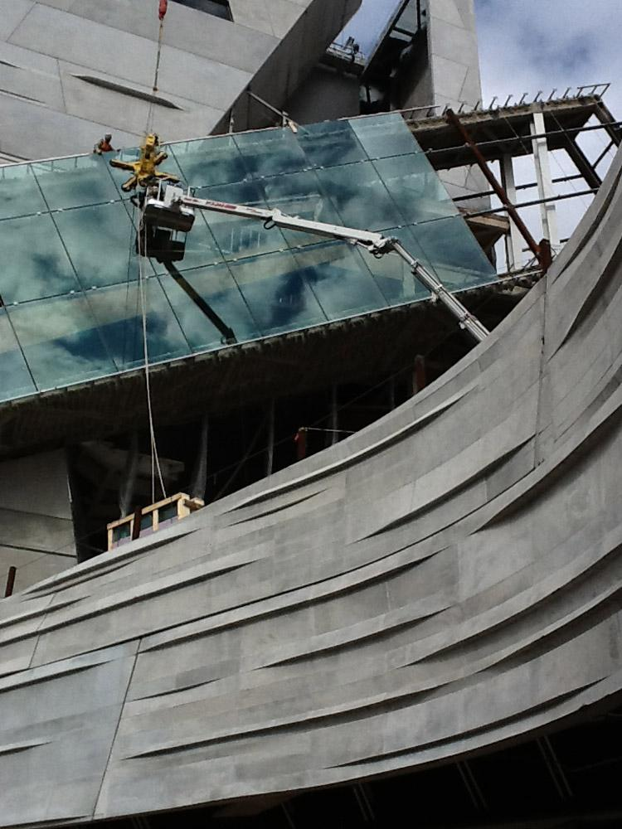
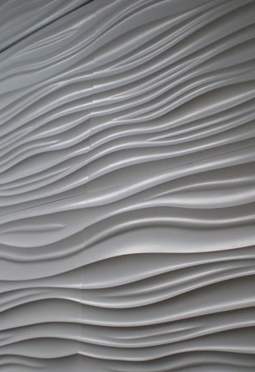
History | Site | Vision | Overview | Education | Theater | Lobby | Facade | Escalator 19
Notes:
As AE students, we know better than anyone how the advanced construction technology have changed our life. Like the architect said, the museum itself is a exhibit. When I saw the

Slide 41
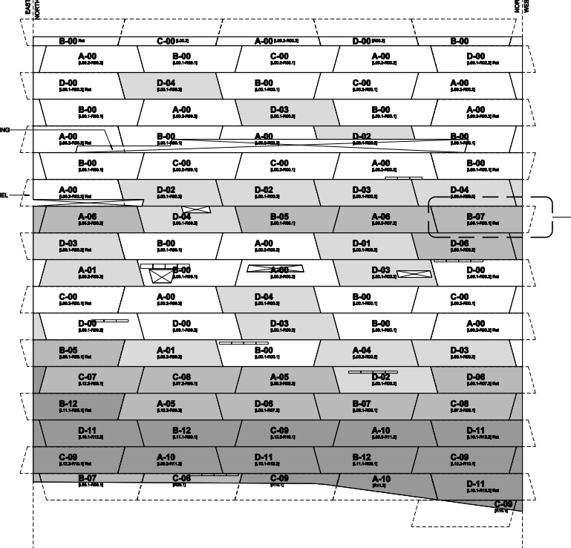
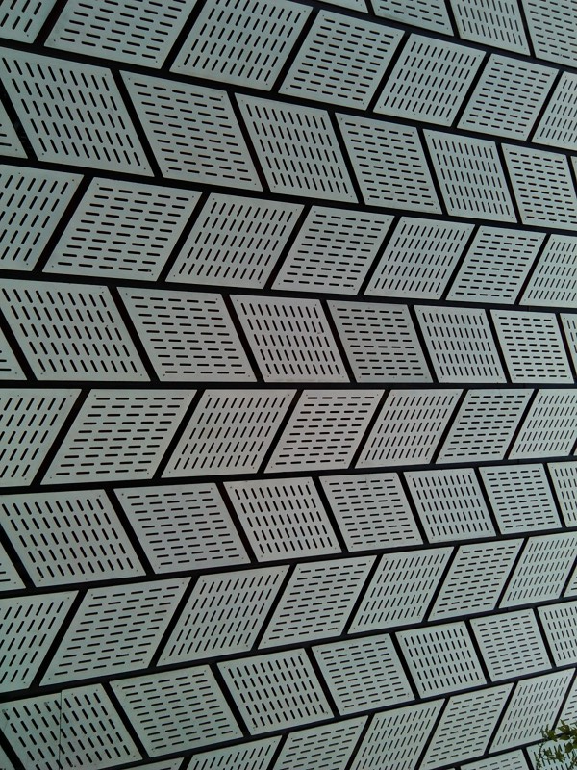
History | Site | Vision | Overview | Education | Theater | Lobby | Facade | Escalator 20
Notes:
As AE students, we know better than anyone how the advanced construction technology have changed our life. Like the architect said, the museum itself is a exhibit. When I saw the iconic texture on the façade, I always relate it to an acoustic material. And even the way how concrete panels align with each other is similar to acoustic material

Slide 42
History | Site | Vision | Overview | Education | Theater | Lobby | Facade | Escalator 20
Notes:
As AE students, we know better than anyone how the advanced construction technology have changed our life. Like the architect said, the museum itself is a exhibit. When I saw the iconic texture on the façade, I always relate it to an acoustic material. And even the way how concrete panels align with each other is similar to acoustic material

Slide 43
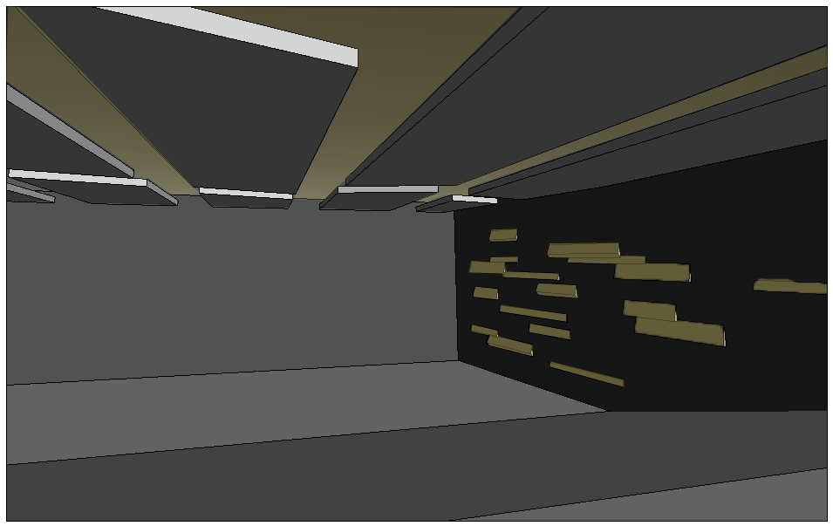
History | Site | Vision | Overview | Education | Theater | Lobby | Facade | Escalator 21
Notes:
As AE students, we know better than anyone how the advanced construction technology have changed our life. Like the architect said, the museum itself is a exhibit. When I saw the iconic texture on the façade, I always relate it to an acoustic material. And even the way how concrete panels align with each other is similar to acoustic material. Therefore I decide to introduce the exterior façade into the theater, promoting an architectural consistency. Similar to the first design, acoustic panel divides the space into multiple sections and contrast of light level can be used to navigate audience.

Slide 44
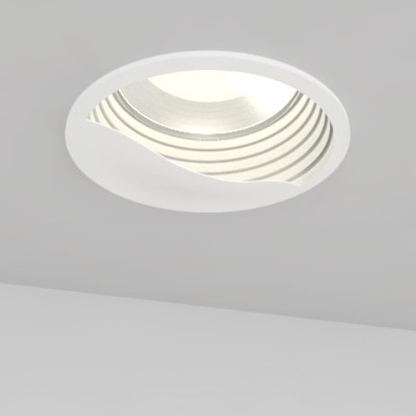
History | Site | Vision | Overview | Education | Theater | Lobby | Facade | Escalator 21
Notes:
As AE students, we know better than anyone how the advanced construction technology have changed our life. Like the architect said, the museum itself is a exhibit. When I saw the iconic texture on the façade, I always relate it to an acoustic material. And even the way how concrete panels align with each other is similar to acoustic material. Therefore I decide to introduce the exterior façade into the theater, promoting an architectural consistency. Similar to the first design, acoustic panel divides the space into multiple sections and contrast of light level can be used to navigate audience.

Slide 45
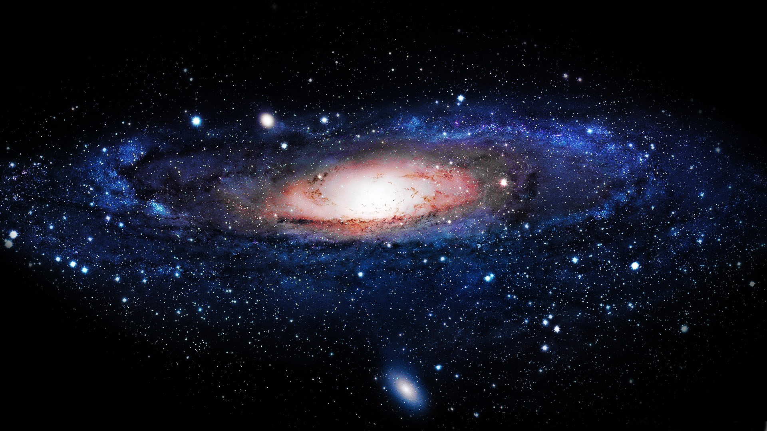
History | Site | Vision | Overview | Education | Theater | Lobby | Facade | Escalator 22
Notes:
Both computer and construction are technologies that people are well aware of. However, there are also science subjects whose benefit to mankind of not obvious yet definite. The study of astronomy not only allowed us to explore the unknown space, but also drives us to think what made us unique in the universe, seeking the ture meaning of humanity.
When speaking of a galaxy, most kids will draw a spiral on the paper. I want use my design to show them that the universe is around us, compared to its scale we are characters on a piece of paper.

Slide 46
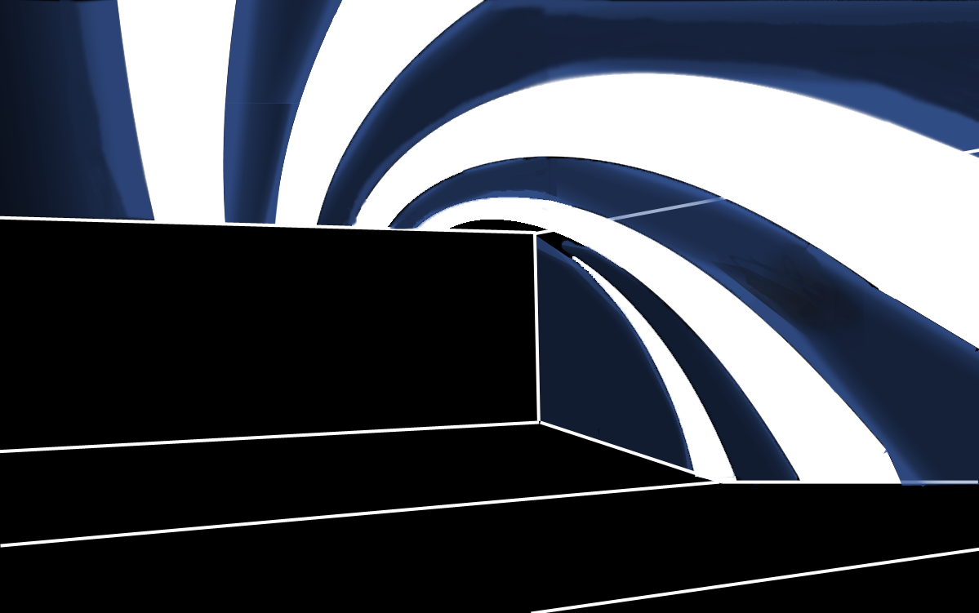
History | Site | Vision | Overview | Education | Theater | Lobby | Facade | Escalator 23
Notes:
Both computer and construction are technologies that people are well aware of. However, there are also science subjects whose benefit to mankind of not obvious yet definite. The study of astronomy not only allowed us to explore the unknown space, but also drives us to think what made us unique in the universe, seeking the ture meaning of humanity.
When speaking of a galaxy, most kids will draw a spiral on the paper. I want use my design to show them that the universe is around us, compared to its scale we are characters on a piece of paper.
Customized acoustic panel will rotate in a 3 dimentional way, providing cove lighting with blue color enhance to show the tune of a universe
Decorative luminaires will pluged on the ceiling to represent starts. When an area is occupied, star fixtures will go off. Therefore if you need a seat, look for starts!

Slide 47
History | Site | Vision | Overview | Education | Theater | Lobby | Facade | Escalator 23

Slide 48
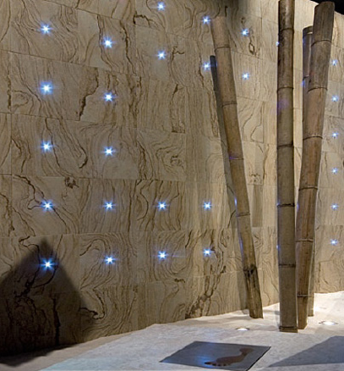
History | Site | Vision | Overview | Education | Theater | Lobby | Facade | Escalator 23

Slide 49
History | Site | Vision | Overview | Education | Theater | Lobby | Facade | Escalator 24

Slide 50
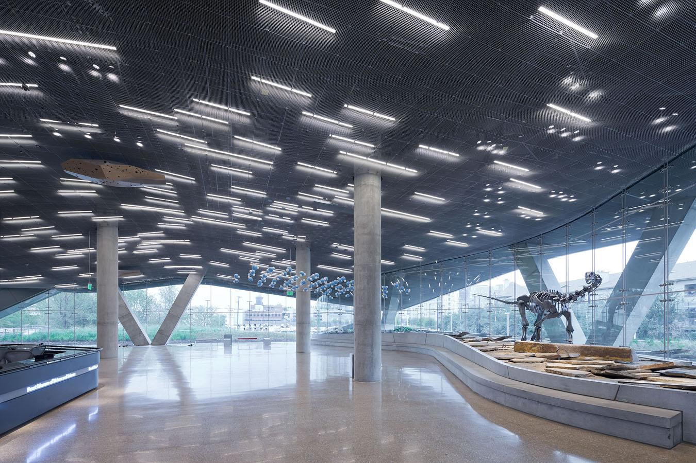
History | Site | Vision | Overview | Education | Theater | Lobby | Facade | Escalator 25
Notes:
The next space I will introduce is the lobby. In the lobby over 200 fluorescent luminaires are distribute on over the ceiling in a scatter way with no clear pattern. On the right side is a very special feature with part of the landscape plinth merged into the interior space, however the color of rock surface is similar to the color of floor time, made it harder for people to realize this unite of exterior and interior space.
Another thing worth mentioning is the decorative architectural element on the ceiling, designed to project textured light on the floor.

Slide 51
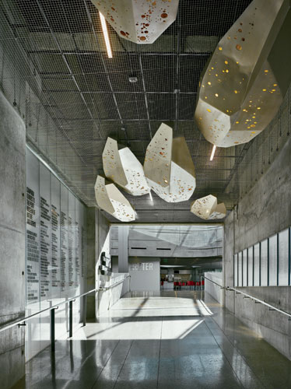
History | Site | Vision | Overview | Education | Theater | Lobby | Facade | Escalator 25

Slide 52
Design Consideration
Fluent light that naturally navigate visitor through a journey
Highlight the intersection of landscape and interior space by using different light colors
Create a visual interest can be observed from outside
Maximize the benefit of daylight from curtain walls
Design Criteria
History | Site | Vision | Overview | Education | Theater | Lobby | Facade | Escalator 25
Notes:
In order to solve the current issue, we need to arrange luminaire in a more uniform pattern to guide the flow of visitors. Lighting must also help people to realize the contrast of landscape plinth and the floor surface. Also, daylight integration will also be an important topic since then entire lobby is surrounded by curtain walls.

Slide 53
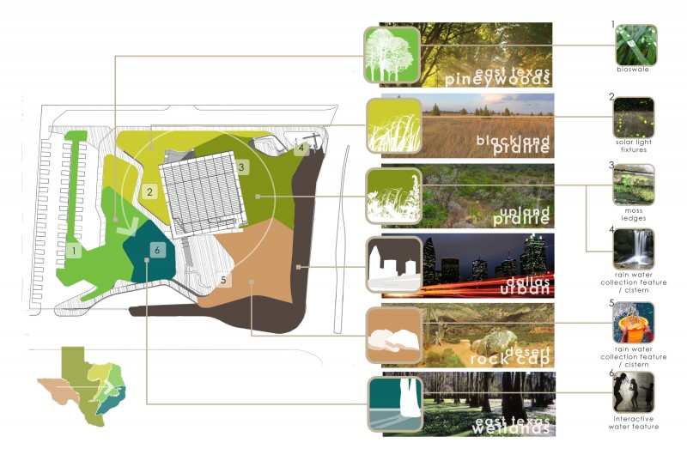
History | Site | Vision | Overview | Education | Theater | Lobby | Facade | Escalator 27
Notes:
The landscape designer did an excellent job on reflecting the native Dallas geology into the size. Walking around the museum, visitors will experience a journey through landscape, witness how simple life from like grass changes into trees as the environment changes.
However, I can’t help notice that this Dallas map is missing an important part. The ocean
Being one of the hottest state in US, Texas's beach is favored by many of its residences. We can event say that beach tour during holiday is part of the urban culture. Even the evolution of the life form starts from the ocean. Therefore I would love to bring the ocean into the building, making the space feels like a fantasy world. The merging feature of the landscape even offered us a perfect boundary line between ocean and the land, imagine how cool it will be to look at the land from a fish perspective.

Slide 54
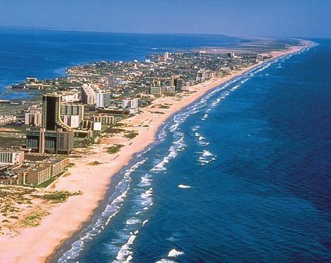
History | Site | Vision | Overview | Education | Theater | Lobby | Facade | Escalator 27

Slide 55
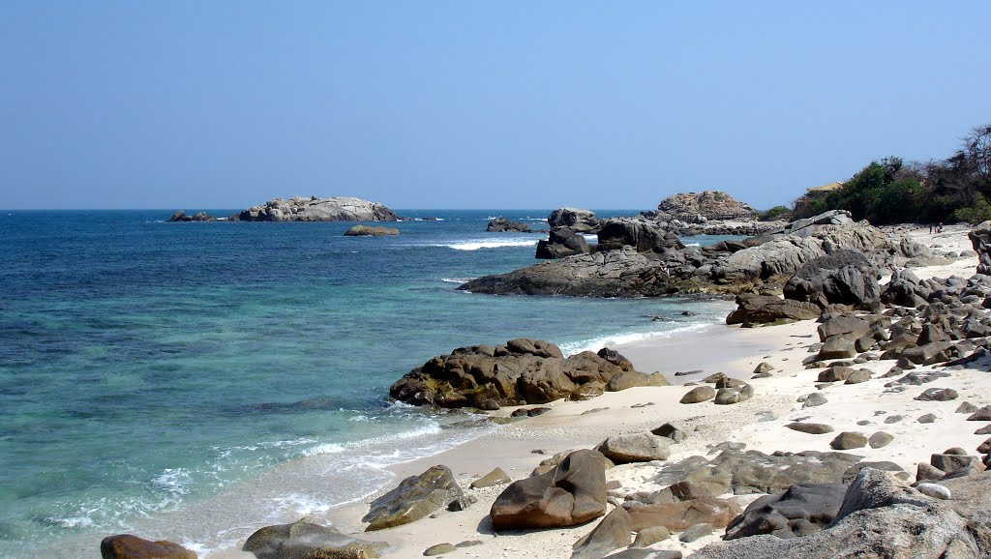
History | Site | Vision | Overview | Education | Theater | Lobby | Facade | Escalator 28

Slide 56
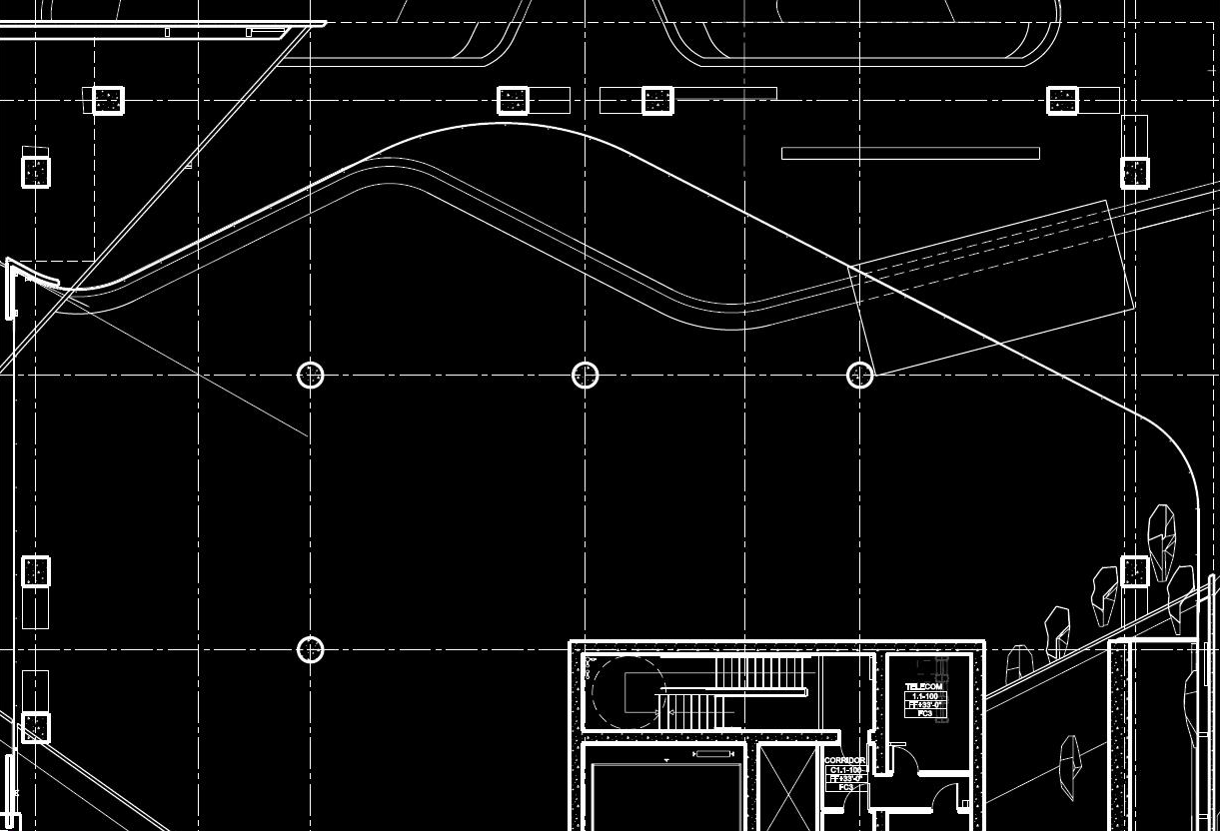
History | Site | Vision | Overview | Education | Theater | Lobby | Facade | Escalator 29
Notes:
The idea is simple. To create a feeling of under water, blue light will be used to dial the floor into clue color while warm white light will be used to enhance the rock texture. Note that both color extended out of the curtain wall to truly unite interior space with the landscape concept.
Blue light will be created by series of spotlights with water texture enhanced by architectural element. General lighting will maintain a linear design with a better continuity, allowing more lumiaire to be ground together creating flowing patterns on the ceiling.

Slide 57
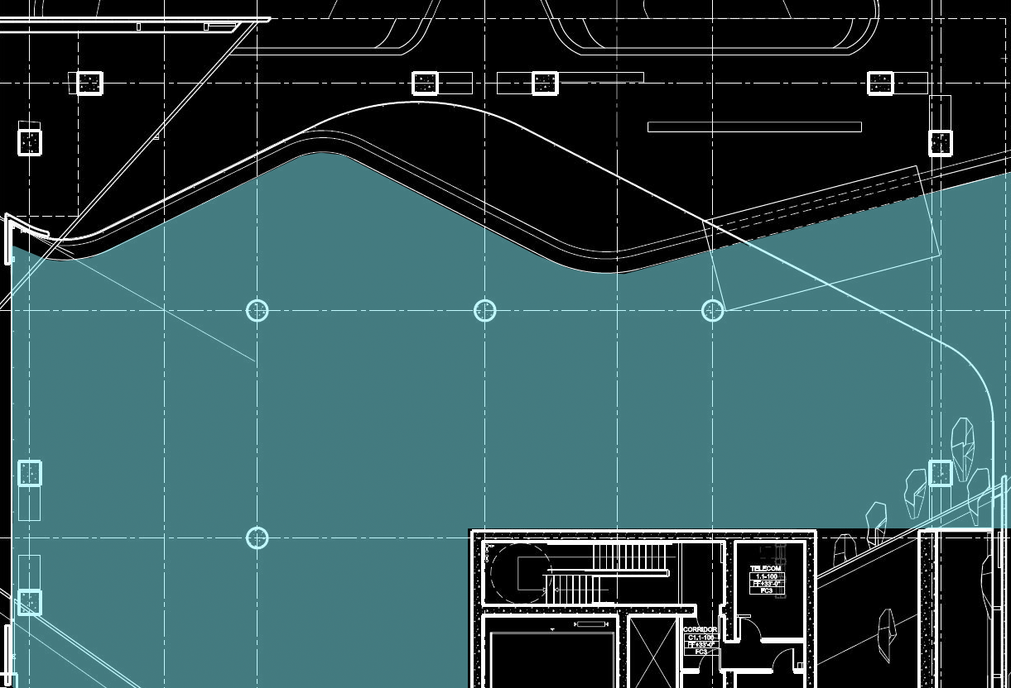
History | Site | Vision | Overview | Education | Theater | Lobby | Facade | Escalator 29

Slide 58
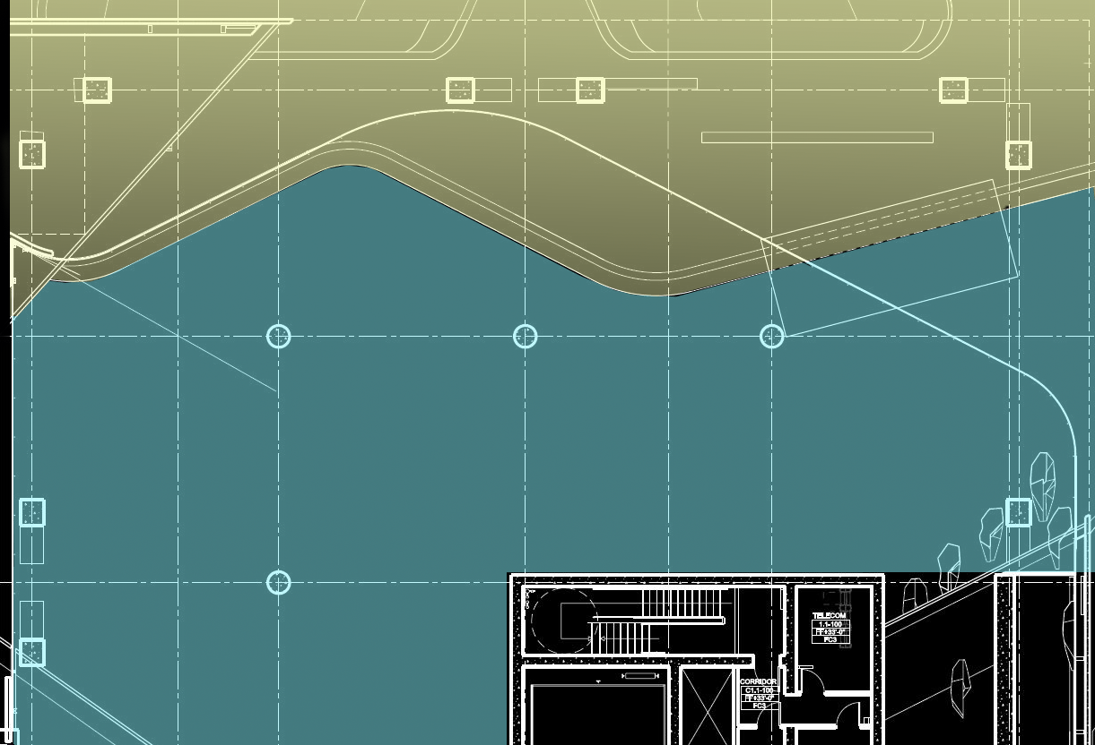
History | Site | Vision | Overview | Education | Theater | Lobby | Facade | Escalator 29

Slide 59
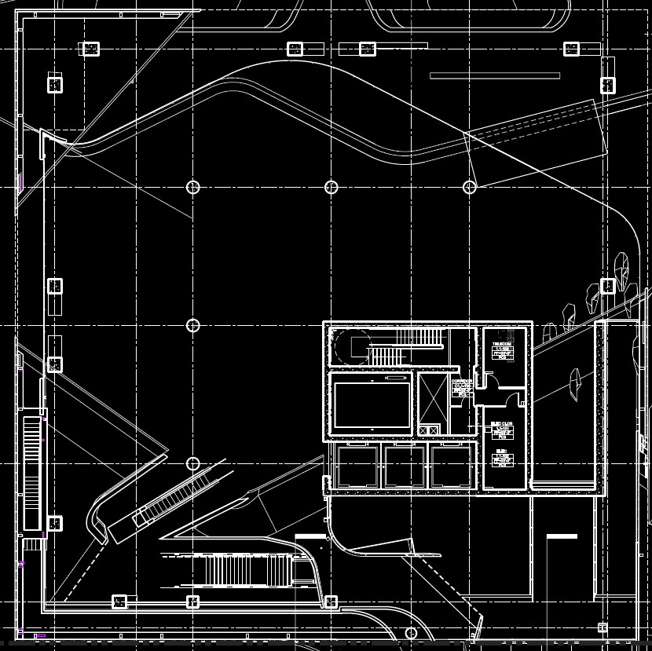
History | Site | Vision | Overview | Education | Theater | Lobby | Facade | Escalator 30
Notes:
Unit of land and ocean but also a unite of interior and exterior experiences

Slide 60
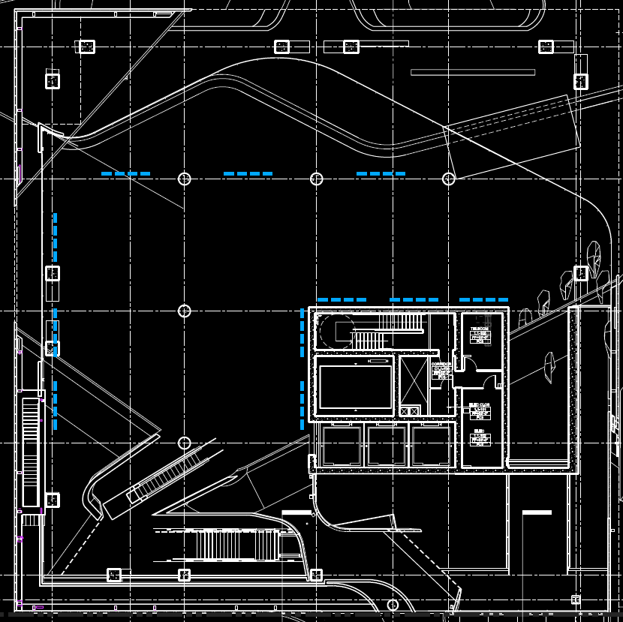
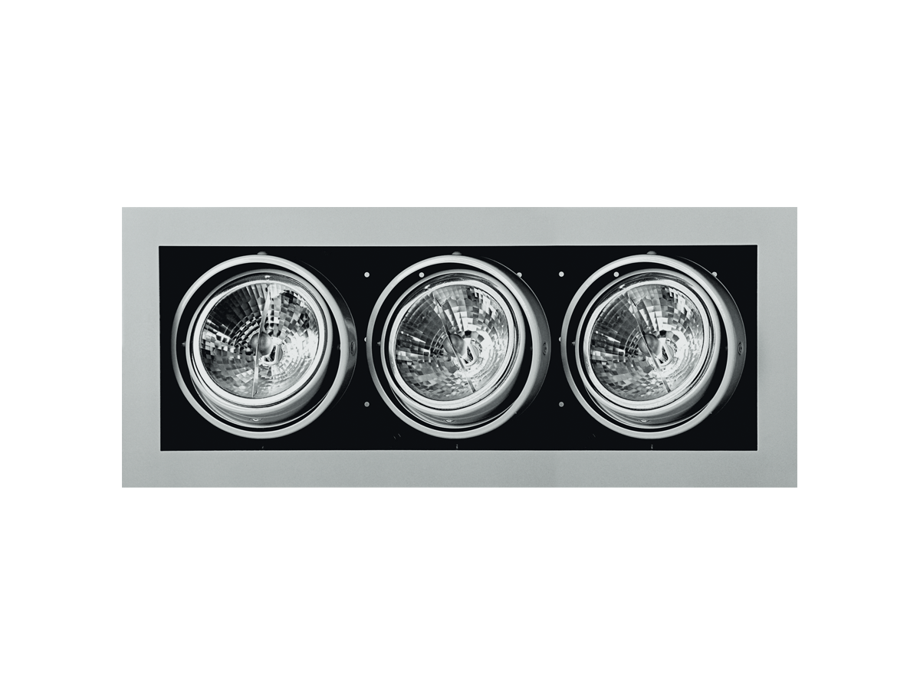
History | Site | Vision | Overview | Education | Theater | Lobby | Facade | Escalator 30
Notes:
Unit of land and ocean but also a unite of interior and exterior experiences

Slide 61
History | Site | Vision | Overview | Education | Theater | Lobby | Facade | Escalator 30
Notes:
Unit of land and ocean but also a unite of interior and exterior experiences

Slide 62
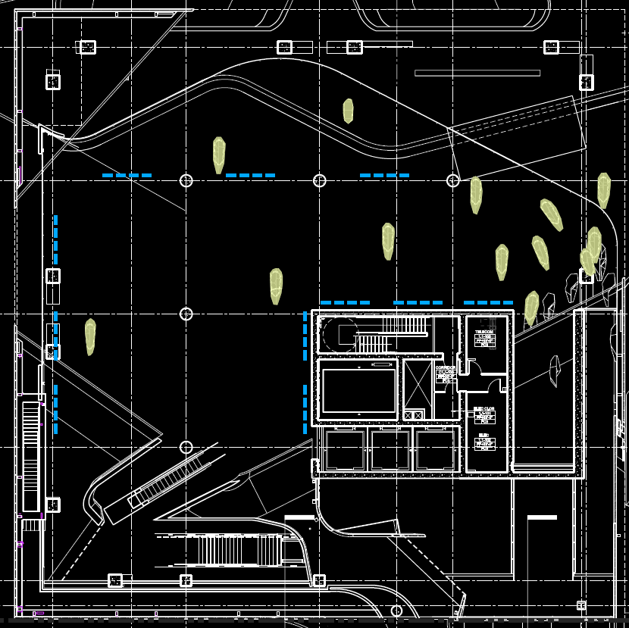
History | Site | Vision | Overview | Education | Theater | Lobby | Facade | Escalator 30
Notes:
Unit of land and ocean but also a unite of interior and exterior experiences

Slide 63
History | Site | Vision | Overview | Education | Theater | Lobby | Facade | Escalator 30
Notes:
Unit of land and ocean but also a unite of interior and exterior experiences

Slide 64
History | Site | Vision | Overview | Education | Theater | Lobby | Facade | Escalator 30
Notes:
Unit of land and ocean but also a unite of interior and exterior experiences

Slide 65
History | Site | Vision | Overview | Education | Theater | Lobby | Facade | Escalator 30
Notes:
Unit of land and ocean but also a unite of interior and exterior experiences

Slide 66
History | Site | Vision | Overview | Education | Theater | Lobby | Facade | Escalator 31
Notes:
I believe we all agree that façade is one of the design height for this project. Forms extruded from the surface not only catches attention but also catches light to crate inspiring contrasts.
However, current façade lighting focused on uniformity, mounting flood lights about 100 feet from the façade.
Escalator on the fourth floor is also a significant part of the façade lighting with its back and side surface glowing.
My design idea for this space is to highlight the texture while try to conceal the luminaire.
To children, such massive gigantic structure like this is exactly what a castle is. Most of the castles are light not in a uniform way but rather having the light fade out on the top to exaggerate its height. In this case we will even have textures on the bottom of the façade.

Slide 67
History | Site | Vision | Overview | Education | Theater | Lobby | Facade | Escalator 32

Slide 68
Design Consideration
Highlight the iconic texture on both the south facade and plinth facade
Hide luminaires to maintain the integrity of the structure
Design Criteria
History | Site | Vision | Overview | Education | Theater | Lobby | Facade | Escalator 33

Slide 69
History | Site | Vision | Overview | Education | Theater | Lobby | Facade | Escalator 34

Slide 70
History | Site | Vision | Overview | Education | Theater | Lobby | Facade | Escalator 35

Slide 71
History | Site | Vision | Overview | Education | Theater | Lobby | Facade | Escalator 35

Slide 72
History | Site | Vision | Overview | Education | Theater | Lobby | Facade | Escalator 36
Notes:
Additional to our require space in this project, I could not help myself to design this amazing escalator space and make it one of a kind experience for visiting chirdrens

Slide 73
History | Site | Vision | Overview | Education | Theater | Lobby | Facade | Escalator 37
Notes:
The escalator chamber is 150 feet long, with escalator traveling 54 feet from fourth floor to the fifth floor. On the right side is a glass wall that allows visitor to look out towards downtown area. On the other side, however, the first two third will be a solid wall few feet from the escalator and in the end the view suddenly expands, allow visitor to see the core of the building.
The original design took a functional approach and had one continuous LED on the ceiling.
First I will use relative motion, which is the most effective way to cheat the perception of speed
Then I will also use exggrated perspective lines to make people think the distance is longer than they actually are
Phycological enhancement from john flynn’s model suggested a cool light temperature and ununiform light to make visitor feel tension and enclosure, both enhancing the speed feeling.
In the end, I will hang decortive features like small planets at the opening of the last section to make it feels like they have reaches the universe.

Slide 74
Design Consideration
Create a journey from enclosure to openness with psychological enhancement especially at night time
Design Criteria
History | Site | Vision | Overview | Education | Theater | Lobby | Facade | Escalator 38

Slide 75
Illusion
Tension
Enclosure
Relative Motion
History | Site | Vision | Overview | Education | Theater | Lobby | Facade | Escalator 39

Slide 76
History | Site | Vision | Overview | Education | Theater | Lobby | Facade | Escalator 40

Slide 77
History | Site | Vision | Overview | Education | Theater | Lobby | Facade | Escalator 40

Slide 78
History | Site | Vision | Overview | Education | Theater | Lobby | Facade | Escalator 40

Slide 79
Reference
P0: http://www.arquitecturabeta.com/2011/08/15/perot-museum-of-nature-science-morphosis/
P1: http://photographyblog.dallasnews.com/2013/06/today-in-dallas-photo-history-1936-texas-centennial-exposition-opens.html/
http://commons.wikimedia.org/wiki/File:Museum_of_Nature_%26_Science_(Fair_Park).JPG
http://www.architecturaldigest.com/architecture/2013-02/best-architectural-projects-slideshow_slideshow_item7_8
P2: http://morphopedia.com/view/perot-museum-of-nature-science-site-1
http://www.freefever.com/stock/2013-latest-dallas-mavericks-wallpaper.jpg
http://upload.wikimedia.org/wikipedia/commons/3/36/Dallas_-_Victory_Tavern_01.jpg
http://www.crunchbase.com/financial-organization/fountain-healthcare-partners
http://beefmagazine.com/blog/let-s-give-bank-america-facts-about-hsus
P3: http://morphopedia.com/projects/perot-museum-of-nature-and-science-1
P4: http://investingindallas.files.wordpress.com/2013/08/2430-victory-park-ln-2404-photo-1.jpg
http://imgpot.com/stalactites
http://farm9.staticflickr.com/8291/7822054812_040cace8f5_z.jpg

